Slide 1
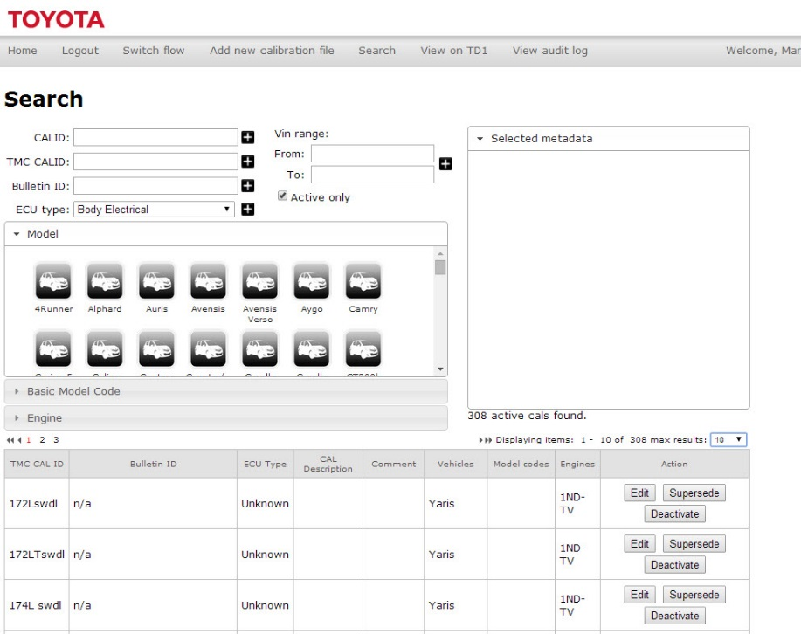
CAL Database User Guide
TME Users Only
TOYOTA MOTOR EUROPE
TOYOTA

Slide 2
Contents
# | Topics | Link
1 | Introduction
2 | Search the database | Go
3 | Add a new CAL file | Go
TOYOTA MOTOR EUROPE
TOYOTA

Slide 3
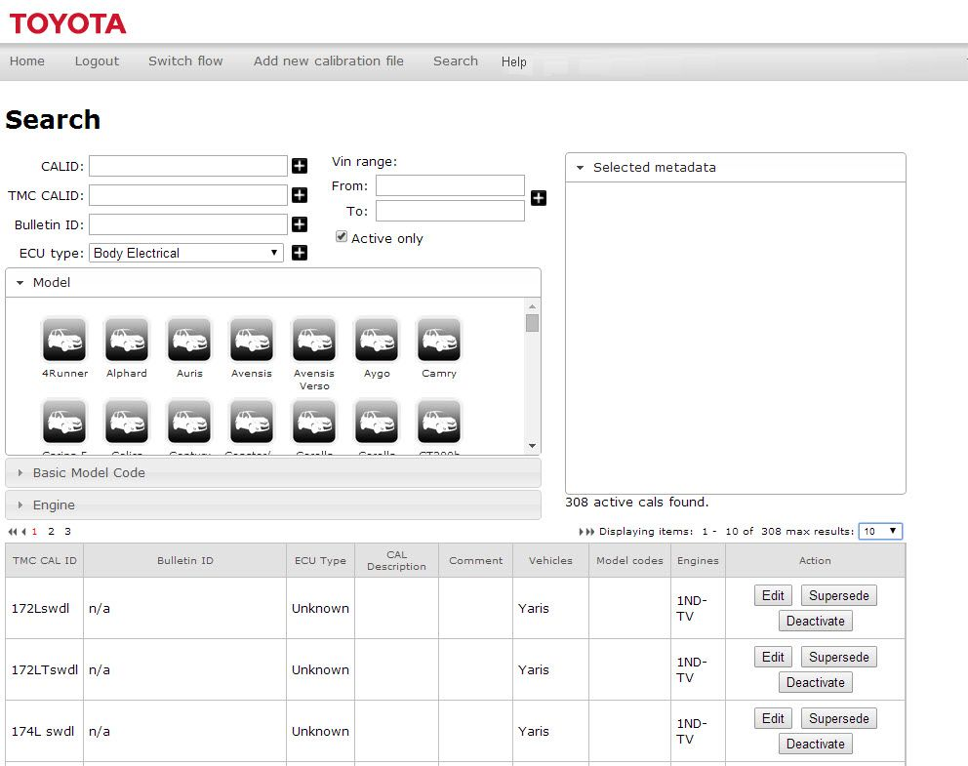
Introduction.
TOYOTA MOTOR EUROPE
TOYOTA

Slide 4
The user interface.
TOYOTA MOTOR EUROPE
TOYOTA

Slide 5
Search the database.
TOYOTA MOTOR EUROPE
TOYOTA

Slide 6
Add a new CAL file.
TOYOTA MOTOR EUROPE
TOYOTA

Slide 7
Edit a CAL file.
TOYOTA MOTOR EUROPE
TOYOTA

Slide 9
End

